Slide 1
KPMG’s Trusted AI Framework

Slide 2
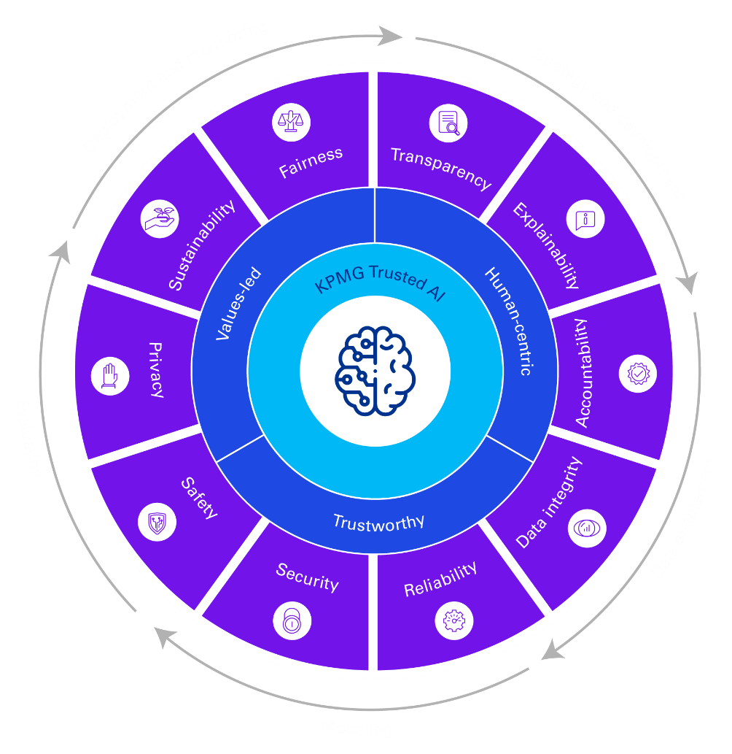
KPMG Trusted AI
We understand trustworthy and ethical AI is a complex business, regulatory, and technical challenge, and we are committed to helping clients put it into practice.
KPMG Trusted AI is our strategic approach and framework to designing, building, deploying and using AI solutions in a responsible and ethical manner so we can accelerate value with confidence.
Values-driven
We implement AI as guided by our Values. They are our differentiator and shape a culture that is open, inclusive, and operates to the highest ethical standards.
Human-centric
We are embracing AI to empower and augment human capabilities—to unleash creativity and improve productivity in a way that allows people to reimagine how they spend their days.
Trustworthy
We will strive to ensure our data acquisition, governance, and usage practices uphold ethical standards and comply with applicable privacy and data protection regulations, as well as any confidentiality requirements.

Slide 3
The KPMG Trusted Al ethical pillars
How we aim to deliver our commitments
At KPMG, our approach to trusted Al rests on ten ethical pillars across the Al lifecycle:
Fairness
Al solutions should be designed to reduce or eliminate bias against individuals, communities, and groups.
Reliability
Al solutions should consistently operate in accordance with their intended purpose and scope and at the desired level of precision.
Transparency
Al solutions should include responsible disclosure to provide stakeholders with a clear understanding of what is happening in each solution across the Al lifecycle.
Security
Robust and resilient practices should be implemented to safeguard Al solutions against bad actors, misinformation, or adverse events.
Explainability
Al solutions should be developed and delivered in a way that answers the questions of how and why a conclusion was drawn from the solution.
Safety
Al solutions should be designed and implemented to safeguard against harm to people, businesses, and property
Accountability
Human oversight and responsibility should be embedded across the Al lifecycle to manage risk and comply with applicable laws and regulations.
Privacy
Al solutions should be designed to comply with applicable privacy and data protection laws and regulations.
Data Integrity
Data used in Al solutions should be acquired in compliance with applicable laws and regulators and assessed for accuracy, completeness, appropriateness, and quality to drive trusted decisions.
Sustainability
Al solutions should be designed to be energy efficient, reduce carbon emissions, and support a cleaner environment

